Slide 1



MICRO CREDIT: DEFAULTER PROJECT
Presented By:
ABHIJIT SARKAR

Slide 2

INDEX:
Overview
Problem Statement
Problem Understanding
What is Housing Price Prediction?
Importance of Loan Prediction
Exploratory data analysis
Visualizations
Analysis
Data Cleaning Steps
Model Building
Hyper Parameter Tuning
Saving model & predictions for Best Model
Conclusion.

Slide 3
Overview
In this Presentation we will be looking on the :-
How to analyze the dataset of Loan Prediction.
What are EDA steps in cleaning the dataset.
Overall analysis on the problem.
Model building from the train dataset.
Predicting Loan Approval for customer.

Slide 4
Problem Statement
A Microfinance Institution (MFI) is an organization that offers financial services to low-income populations. MFS becomes very useful when targeting especially the unbanked poor families living in remote areas with not much sources of income. The Microfinance services (MFS) provided by MFI are Group Loans, Agricultural Loans, Individual Business Loans and so on. Many microfinance institutions (MFI), experts and donors are supporting the idea of using mobile financial services (MFS) which they feel are more convenient and efficient, and cost saving, than the traditional high-touch model used since long for the purpose of delivering microfinance services. Though, the MFI industry is primarily focusing on low-income families and are very useful in such areas, the implementation of MFS has been uneven with both significant challenges and successes.

Slide 5
Problem Understanding:-
Item 1
Item 2
MOTIVATION FOR THE PROBLEM UNDERTAKEN
Today, microfinance is widely accepted as a poverty-reduction tool, representing $70 billion in outstanding loans and a global outreach of 200 million clients. We are working with one such client that is in Telecom Industry. They are a fixed wireless telecommunications network provider. They have launched various products and have developed its business and organization based on the budget operator model, offering better products at Lower Prices to all value conscious customers through a strategy of disruptive innovation that focuses on the subscriber. They understand the importance of communication and how it affects a person’s life, thus, focusing on providing their services and products to low-income families and poor customers that can help them in the need of hour.
They are collaborating with an MFI to provide micro-credit on mobile balances to be paid back in 5 days. The Consumer is believed to be defaulter if he deviates from the path of paying back the loaned amount within the time duration of 5 days. For the loan amount of 5 (in Indonesian Rupiah), payback amount should be 6 (in Indonesian Rupiah), while, for the loan amount of 10 (in Indonesian Rupiah), the payback amount should be 12 (in Indonesian Rupiah)
Here We need to build a model which can be used to predict in terms of a probability for each loan transaction, whether the customer will be paying back the loaned amount within 5 days of insurance of loan. In this case.
Label [1] indicates that the loan has been paid i.e., non-defaulter.
While:
Label [0] indicates that the loan has not been paid i.e., defaulter.

Slide 6

What Is Loan Prediction:-
Predicting in terms of a probability for each loan transaction, whether the customer will be paying back the loaned amount is checked. By the help of machine learning.

Slide 7

Importance Of Loan Prediction:-
House Predicting loan defaulters is an important process of the banking system as it directly affects profitability.

Slide 8
Exploratory Data Analysis:
As a first step I have imported required libraries and I have imported the datasets which were in csv format.
Then I did all the statistical analysis like checking shape, nunique(unique value each column contains), value counts, info etc.
While checking the info of the datasets I found some columns with more than 90% null values, are dropped as these columns will create skewness in datasets so I decided to drop those columns.
Then while looking into the value counts I found some columns with more than 92% zero values this also creates skewness in the model and there are chances of getting model bias so I have dropped those columns with more than 92% zero values.

Slide 9
Exploratory Data Analysis:
While checking for null values I found null values in most of the columns and I have used imputation method to replace those null values (mode for categorical column and mean for numerical columns).
The Data Set contains 36 columns and 209593 rows. The size of the data is 7545348.
Next as a part of feature extraction I converted pdate and to date time and separated Day, month and year
And all these steps were performed in the dataset.
Used Univariate and Bi-variate Methods to explore the data.

Slide 10
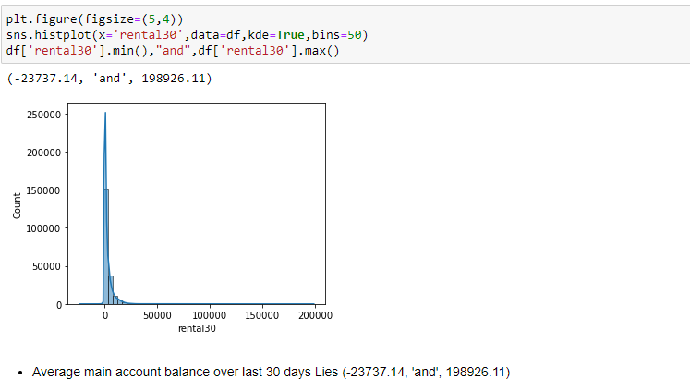
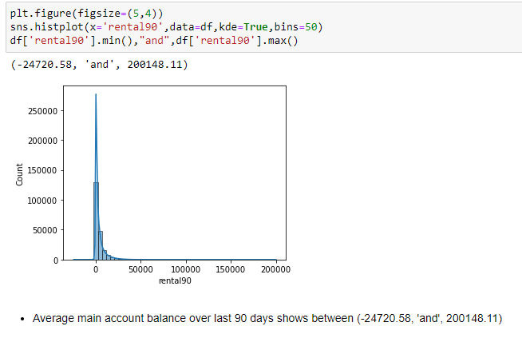
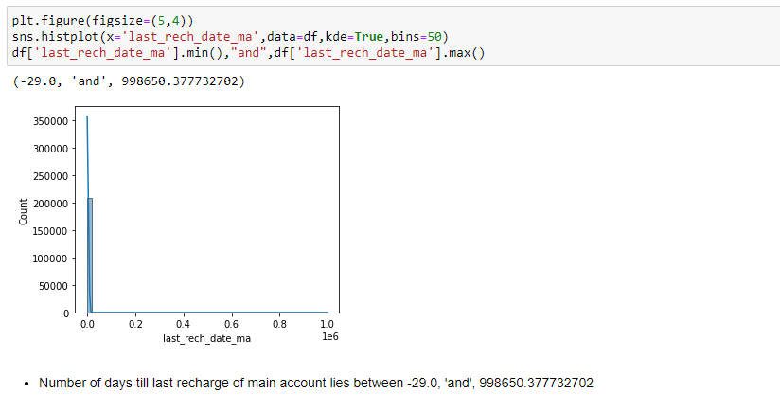
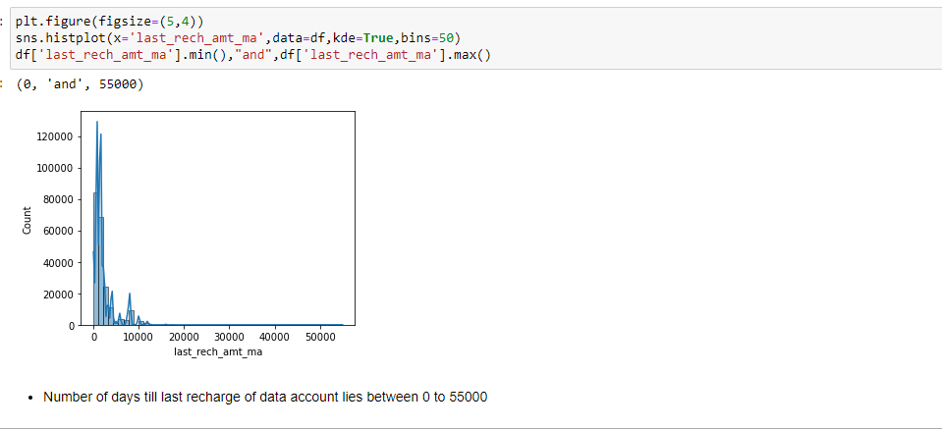
VISUALIZATION OF NUMERICAL COLUMN DATA:

Slide 11
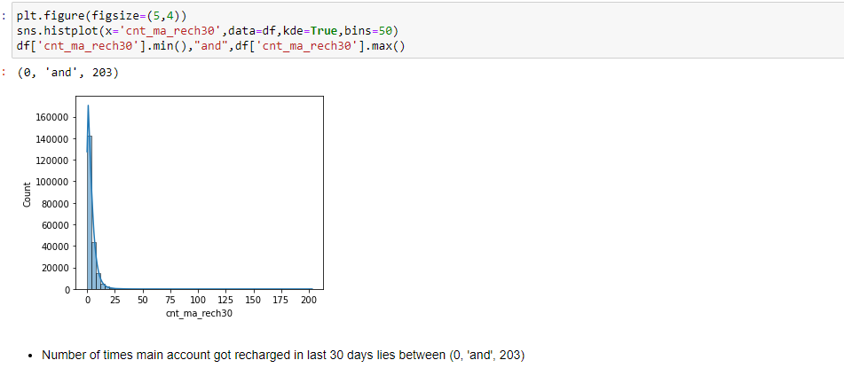
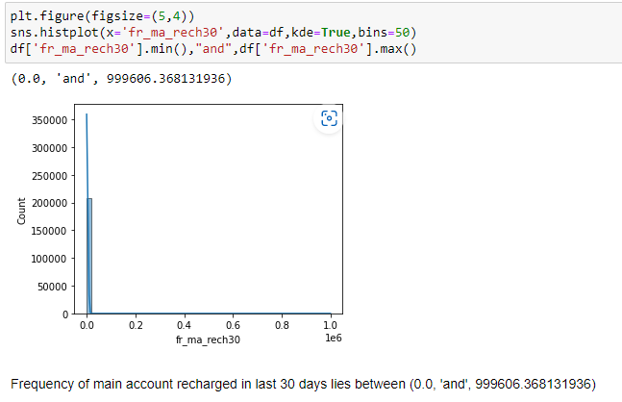
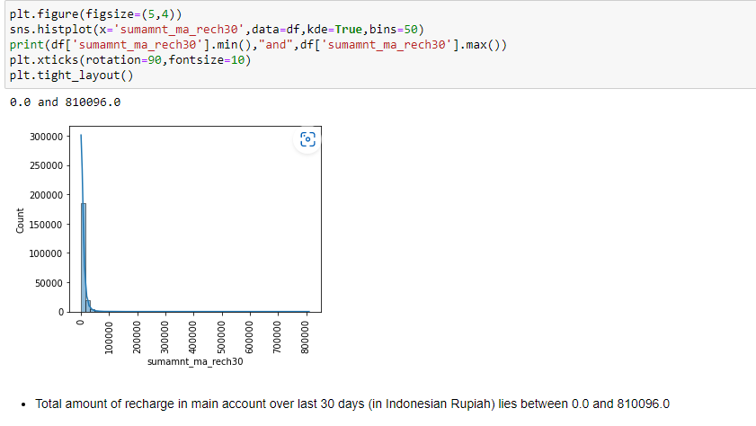
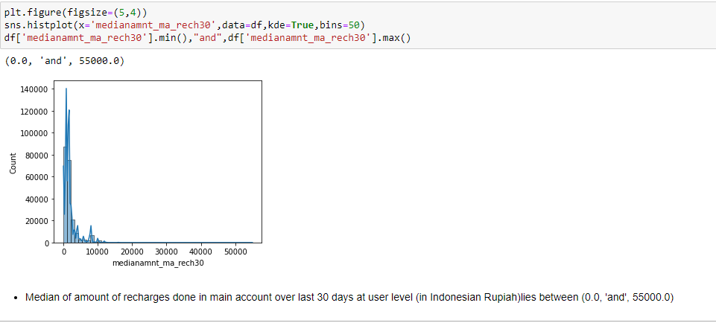
s
Visualization Of Numerical Column Data:-

Slide 12
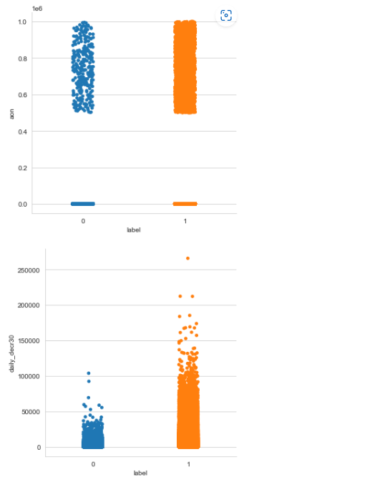
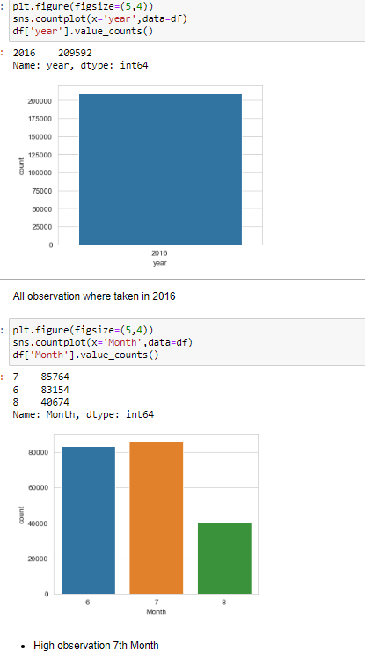
Visualization Of Categorical Column:-

Slide 13
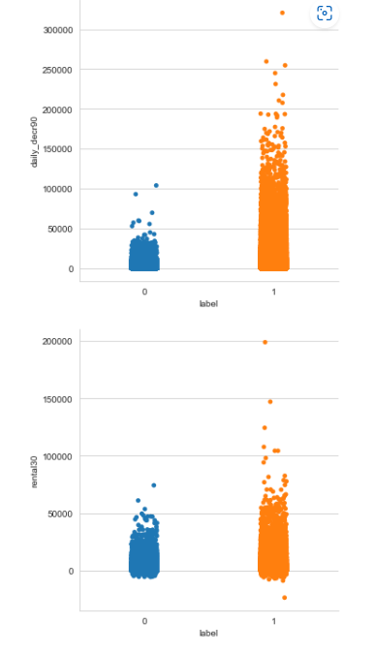
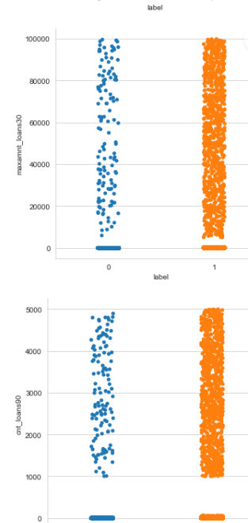
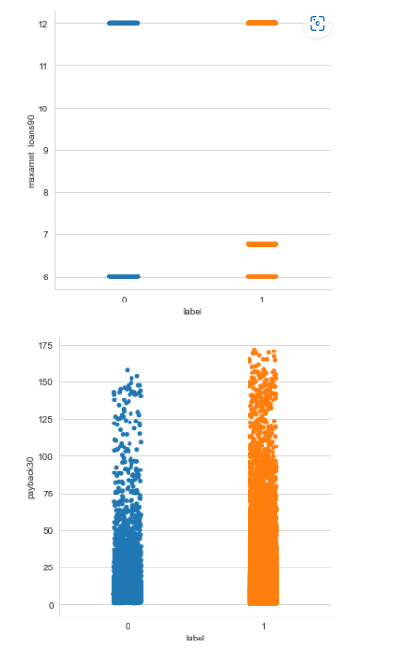
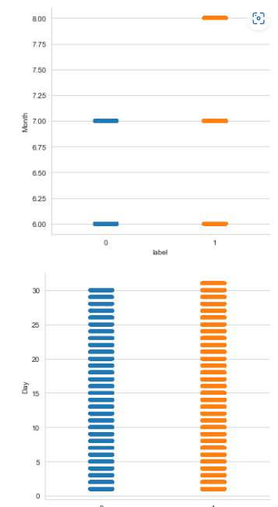
Visualization Of Categorical Column:-

Slide 14
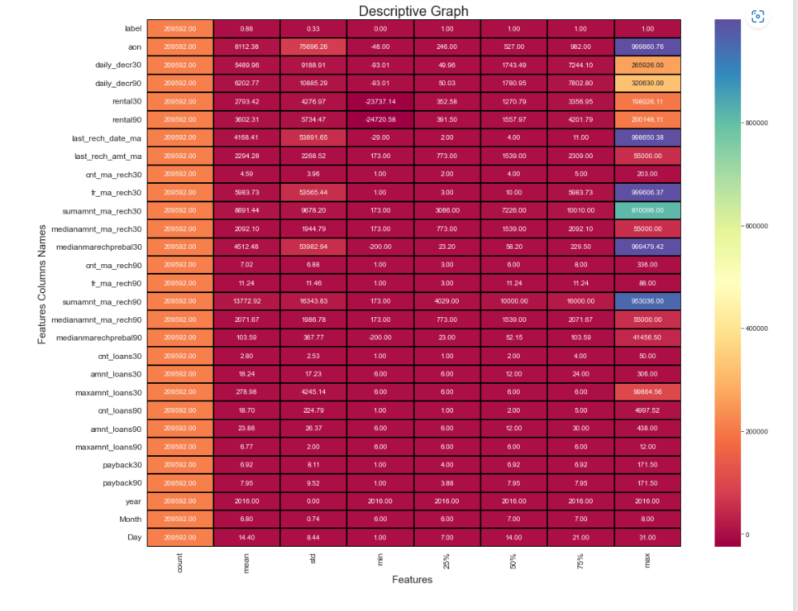
Descriptive Graphs:-

Slide 15
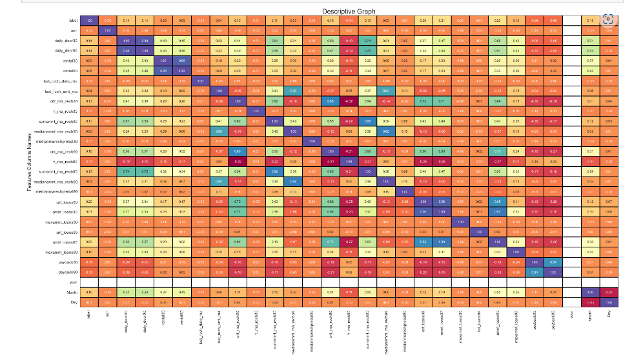
Correlation Graph
For Adjacent to postive off-site feature(PosA) and Near positive off-site feature park, greenbelt, etc. (PosN) Proximity to various conditions (if more than one is present)(Condition2) has maximum SalePrice.
For Single-family Detached(1Fam) and Townhouse End Unit(TwnhsE) type of dwelling(BldgType) the SalePrice is high.
For 2Story and Two and one-half story: 2nd level finished(2.5Fin) Style of dwelling(HouseStyle) the SalePrice is high.
For Shed Type of roof(RoofStyle) the SalePrice is high.
For Wood Shingles(WdShngl) Roof material(RoofMat1) the SalePrice is high.
For Cement Board(CemntBd), Imitation Stucco(ImStucc) and Stone type of Exterior covering on house(Exterior1st) the SalePrice is high.
For Cement Board(CemntBd), Imitation Stucco(ImStucc) and other Exterior covering on house (if more than one material)(Exterior2) has maximum SalePrice.
For Stone Masonry veneer type(MasvnrType) the SalePrice is high.
For Excellent(Ex) quality of the material on the exterior(ExterQual) the SalePrice is high.
For Excellent(Ex) present condition of the material on the exterior(ExterCond) the SalePrice is high.
For Poured Contrete(PConc) Type of foundation(Foundation) the SalePrice is high.
For Excellent(100+ inches)(Ex) height of the basement(BsmtQual) the SalePrice is high.

Slide 16

Data Analysis:-
I have used box plot for each pair of categorical features that shows the relation with the median sale price for all the sub categories in each categorical feature. .
I found that there is a logistic Regression Model Case. Hence used it to find relationship between continuous numerical variable and SalePrice.

Slide 17
Steps Used For Data Cleaning:-
In my datasets I have zero correlation columns , removed outliers and also skewness.
I have used imputation method to replace null values. To remove outliers I have used percentile method. And to remove skewness I have used yeo-johnson method.
Used of Pearson’s correlation coefficient to check the correlation between dependent and independent features.
Also I have used standardization Scaler. Then followed by model building with all regression algorithms.

Slide 18
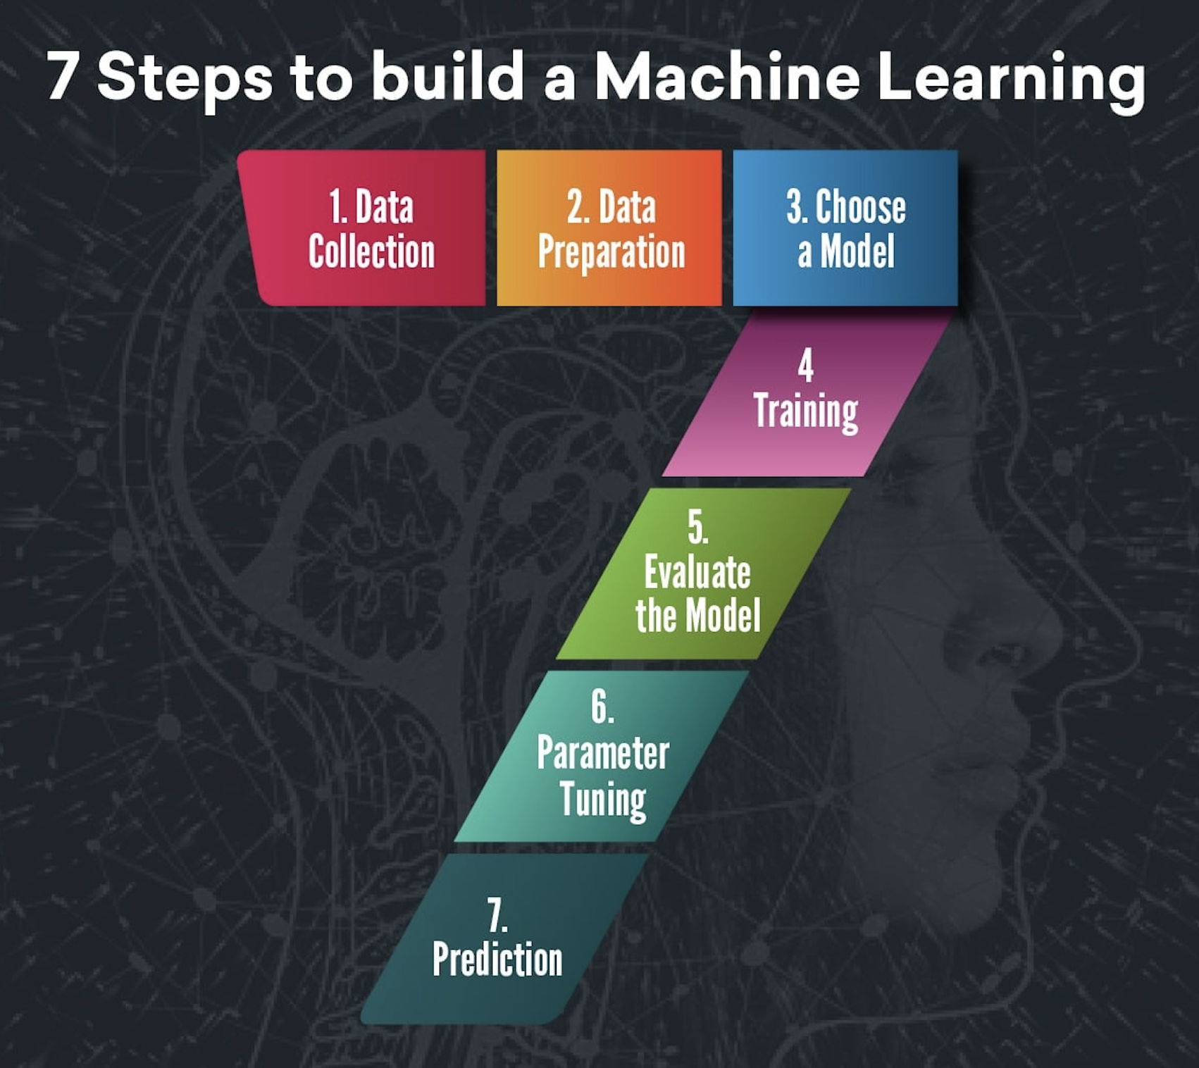
Model Building:-
Since Label was my target and it was a categorical variable ,hence was Logistic Regression problem. And I have used all regression algorithms to build my model.
By looking into the difference of accuracy score and cross validation score I found ExtraTreesRegressor as a best model with least difference.

Slide 19

Algorithms I have used in my project:
Logistic Regression
Decision Tree.
Extra Trees Regressor
Random Forest Regressor
Gradient Boosting Regressor

Slide 20
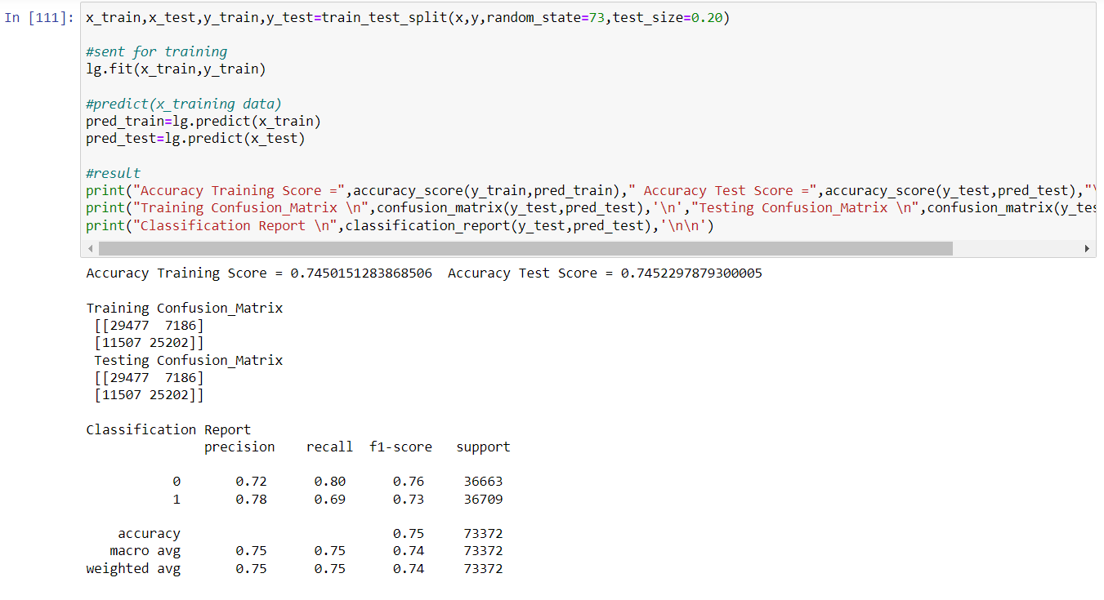
Different Models With Their Performance:-

Slide 21
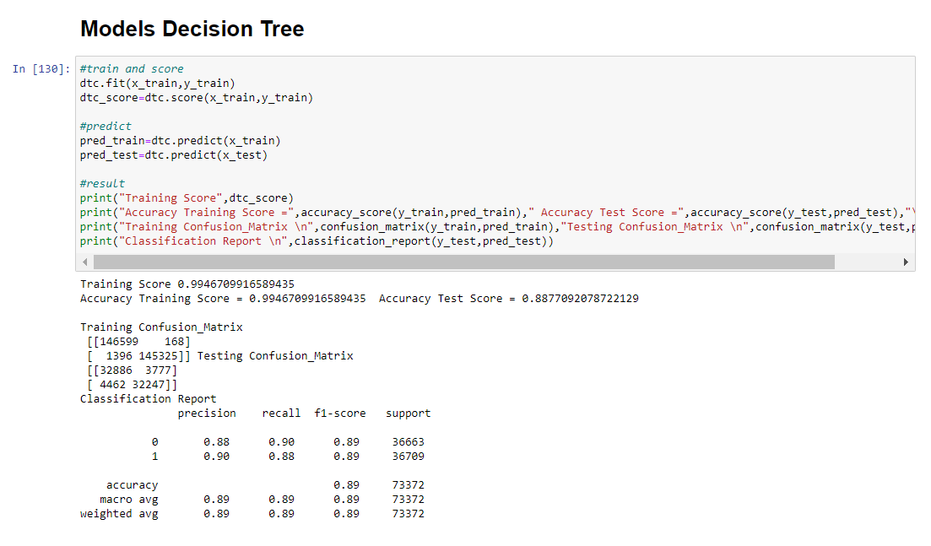
Models With Their Performance:-
Different Models With Their Performance:-

Slide 22
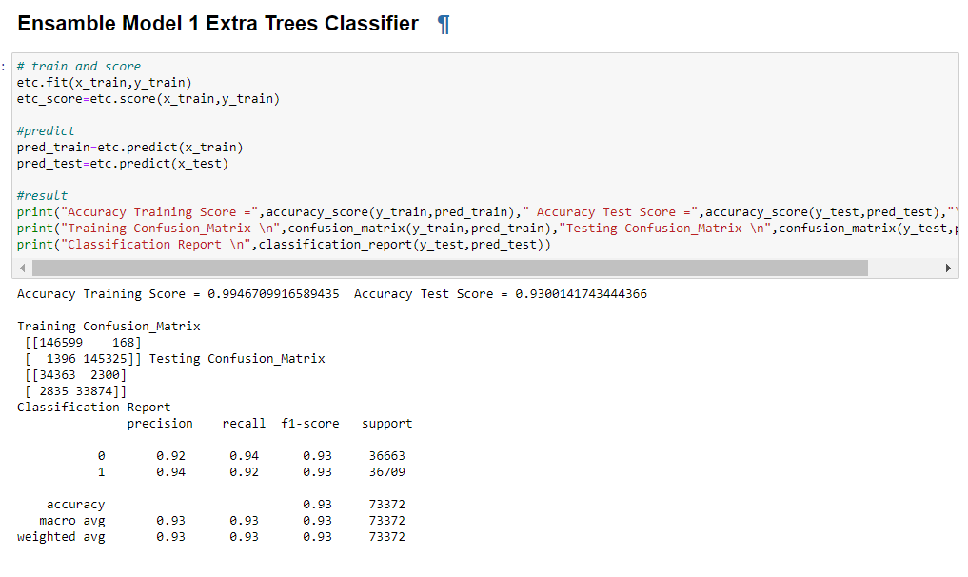
Models With Their Performance:-
Different Models With Their Performance:-

Slide 23
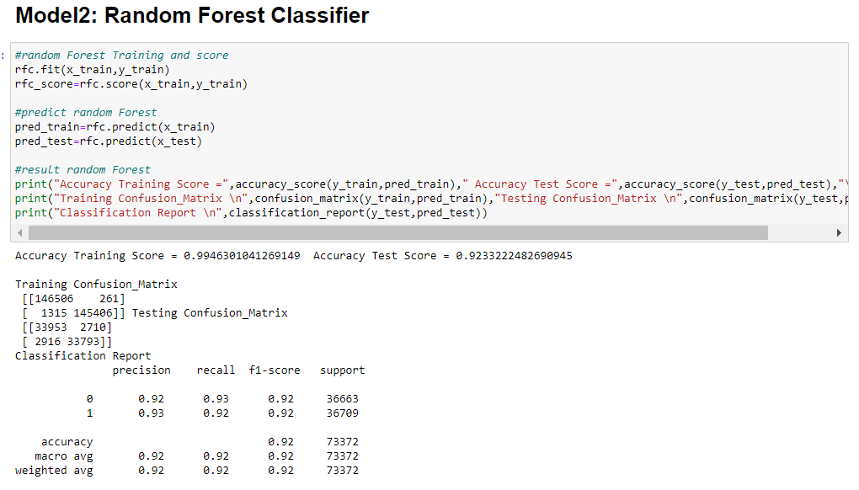
Different Models With Their Performance:-
Different Models With Their Performance:-

Slide 24
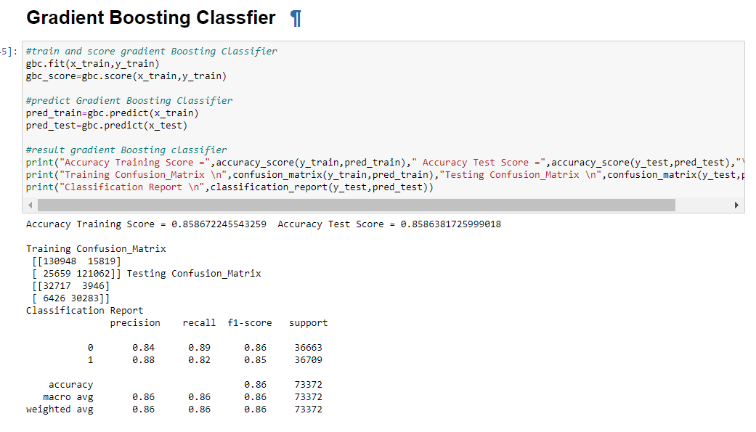
Different Models With Their Performance:-

Slide 25
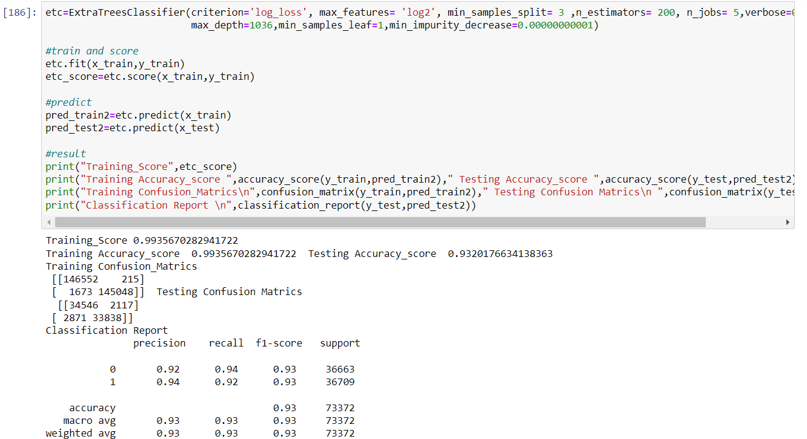
Different Models With Their Performance:-

Slide 26
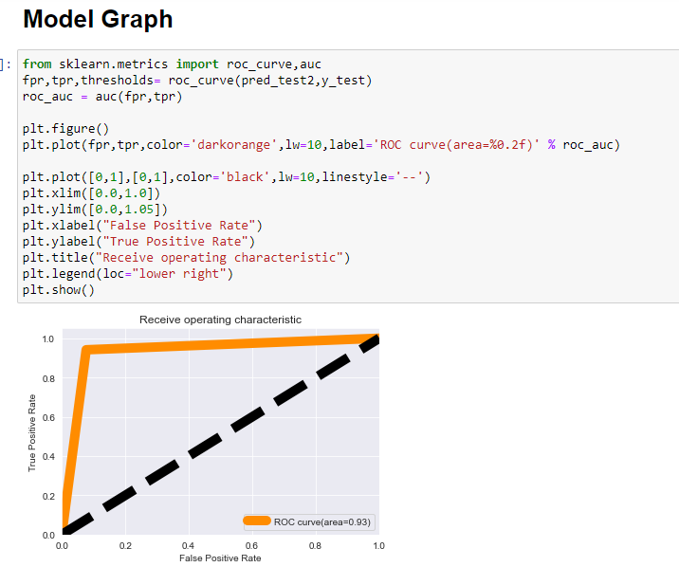
Graph of Saving Model

Slide 27
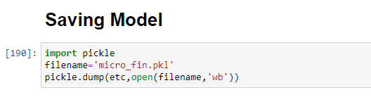
Saving model Best Model:-
I have saved my best model using .pkl as follows.

Slide 28
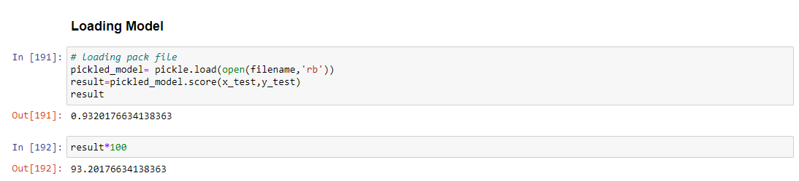
Predictions for Best Model:-
Now after saving the best model, loading my saved model

Slide 29
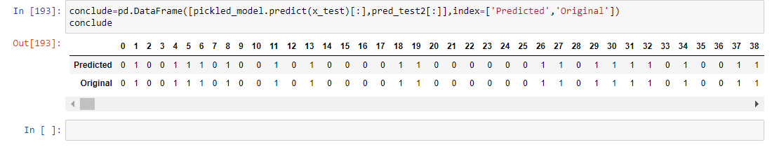
I have predicted the test dataset and the predictions looks good.

Slide 30
Conclusion:
In this project report, we have used machine learning algorithms to predict the loan probability of the customer.
We have mentioned the step by step procedure to analyze the dataset and finding the correlation between the features. Thus we can select the features which are not correlated to each other and are independent in nature.
We calculated the performance of each model using different performance metrics and compared them based on these metrics.
There were large no. of feature present in our dataset, I analyse the data and dropped all the necessary feature.
From overall analysis and visualization i come into conclusion that , the feature that most effect the Label are:
[ 'last_rech_amt_ma', 'cnt_ma_rech30', 'cnt_ma_rech90', 'cnt_loans30', 'amnt_loans30', 'cnt_loans90', 'amnt_loans90', 'Month','Day’, 'Avg_Payback’, 'Avg_Freq_Recharge’, 'Avg_Rental’, 'Avg_Amount_Recharge’ ]

Slide 31
I hope this model will help companies to predict the Loan Approval of Customers. To conclude, the application of machine learning in property research is still at an early stage. We hope this study has moved a small step ahead in providing some methodological and empirical contributions to loan approval.
Conclusion:

Slide 32

Thank You

